Slide 1
Analysis and Prediction of YouTube US Video Statistics Data
Course TITLE - WSP 370: An Introduction to Data Science
Bandhana Sinha
July 2019

Slide 2
Introduction
Goals | Predict the number of likes for YouTube videos, based on the number of views and category identification numbers (“category_id”). Build a user-friendly Shinny interface, to facilitate data analysis.
Data source | Kaggle.com
Sampling Method | Bootstrap
Tools | R packages: Caret, GGPLOT2, readr Plotly Shinny
Process | Data extraction Data import in R Data analysis using visualization techniques Visualize: data distribution, correlation, best fitting line(Regression line), number of likes per category id, outliers Build Shinny interface: visualize data distribution, data insights Construct 3 Machine Learning models using Random Forest, linear model and K-Nearest Visualize model accuracy

Slide 3
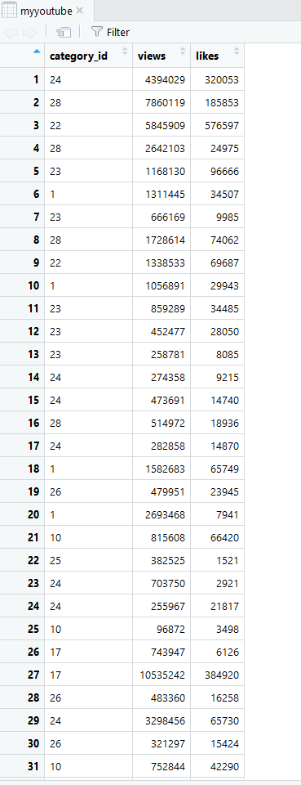
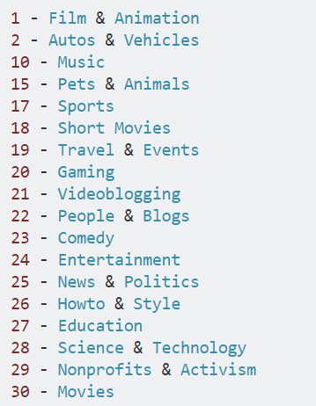
Dataset
Total rows : 100
Total columns : 3 (category_id, views, likes)
YouTube video category id list source: https://gist.github.com/dgp/1b24bf2961521bd75d6c
Snap shot of first 30 rows
of the dataset
YouTube video category id list

Slide 4
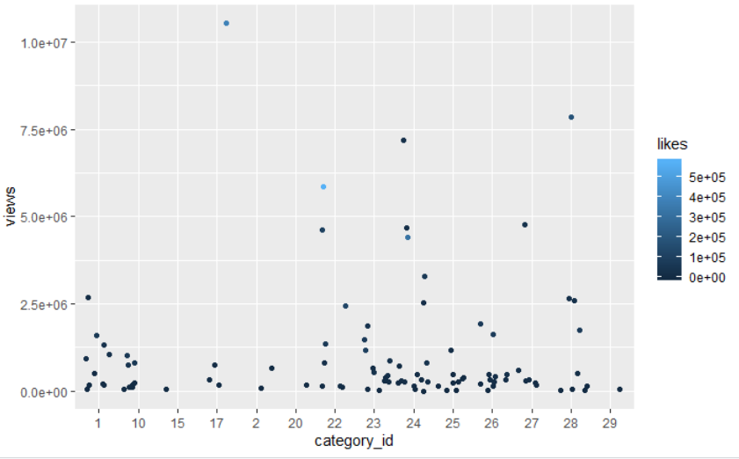
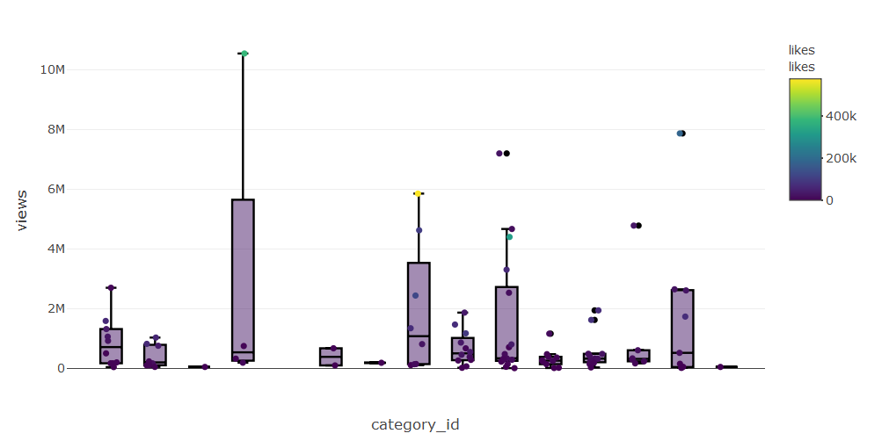
Distribution of data
Overall distribution of data using ggplot 2
Overall distribution of data using Plotly

Slide 5
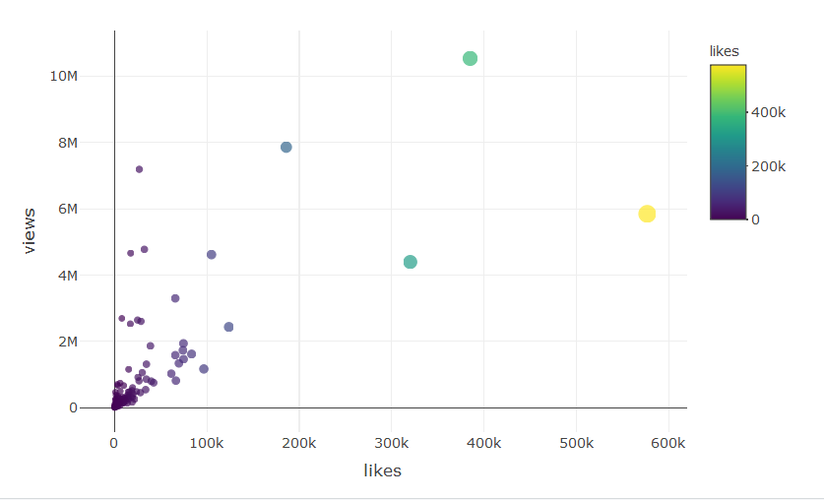
Correlations
Scatter plot showing strong correlation of 0.709145

Slide 6
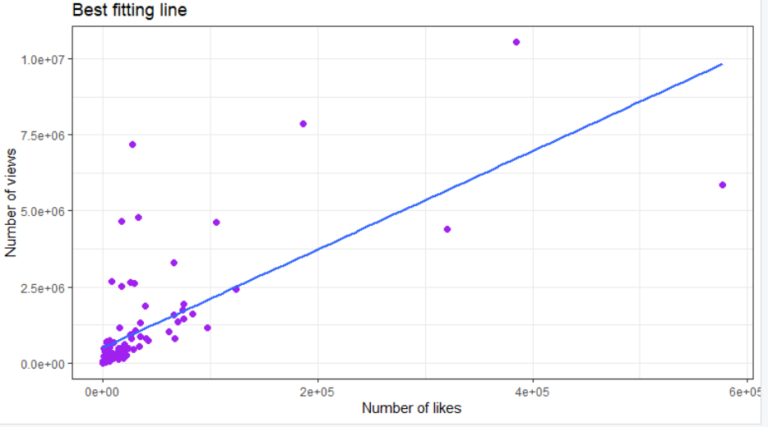
Regression line/best Fitting Line
Linear Regression line

Slide 7
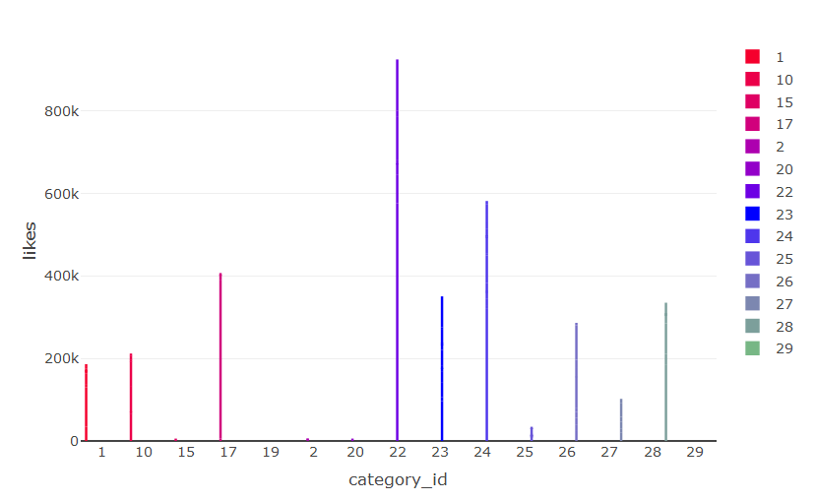
Visualizations
Chart showing number of likes per
category id

Slide 8
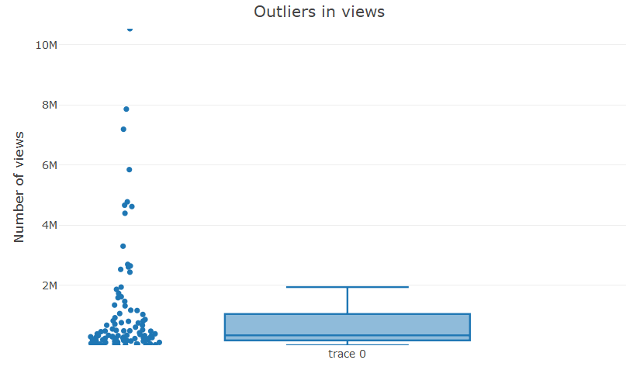
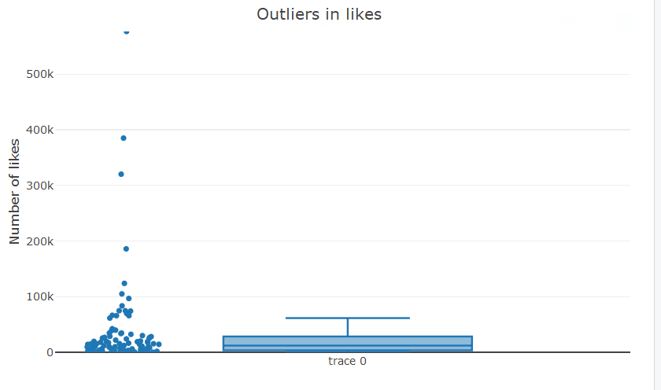
Outliers
Outlier present in likes and views columns

Slide 9
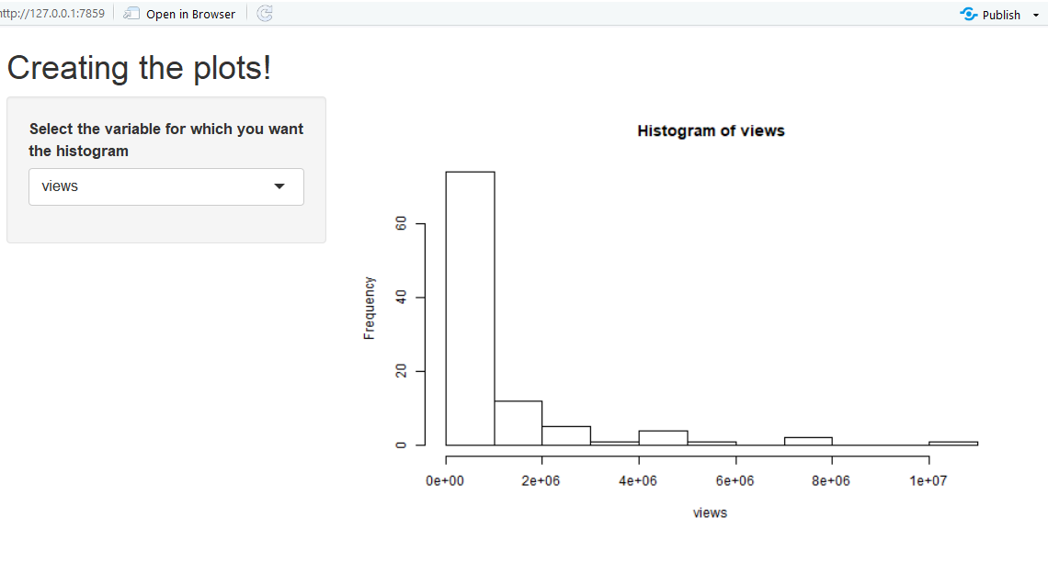
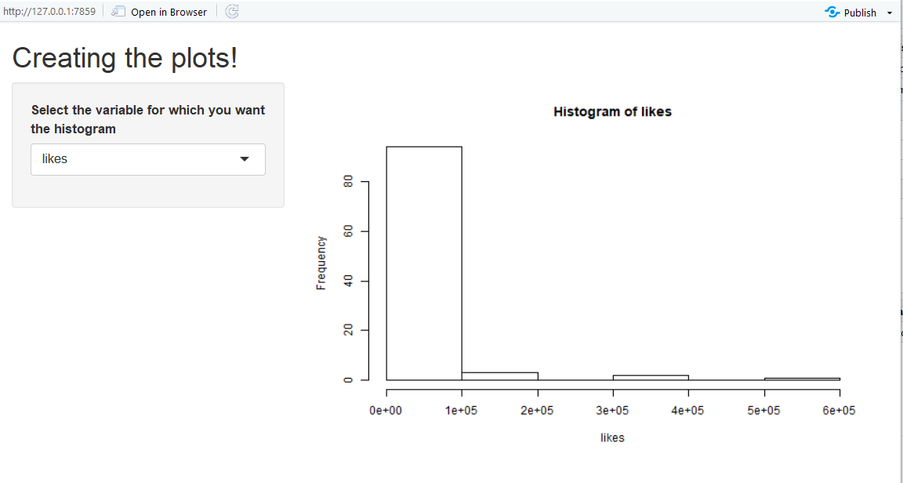
Shinny Histogram plots
Interactive Shinny plots (Histogram) to view distribution of Number of views and likes

Slide 10
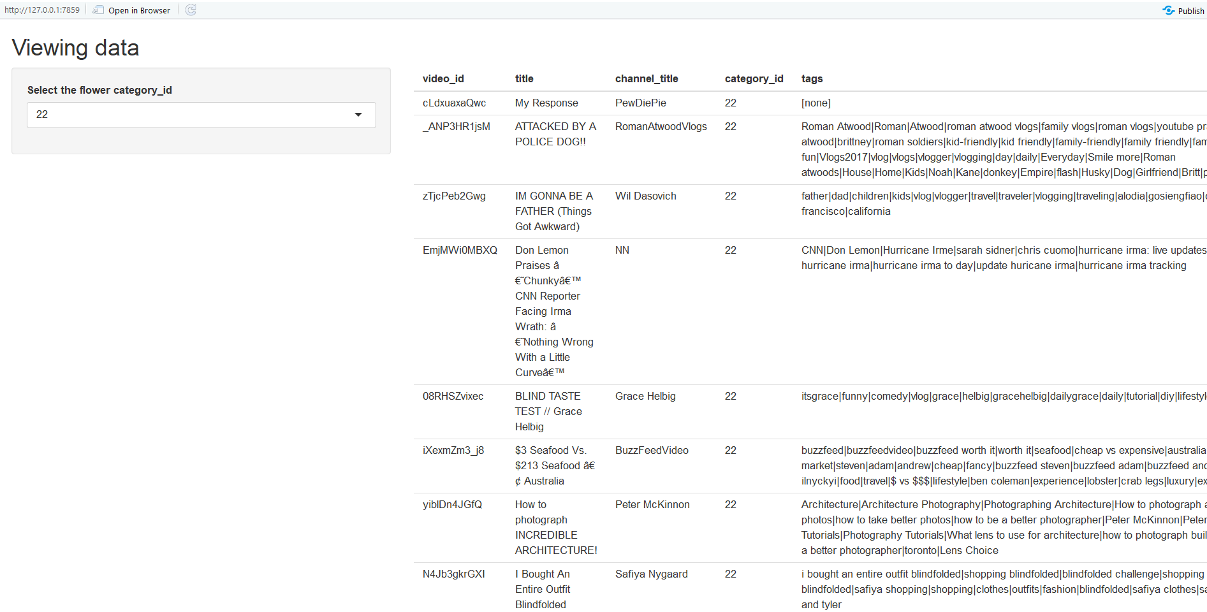
Shinny Plot
Shinny app built to get quick categorical insights.

Slide 11
Models Built
Linear Model
K-nearest
Random Forest

Slide 12
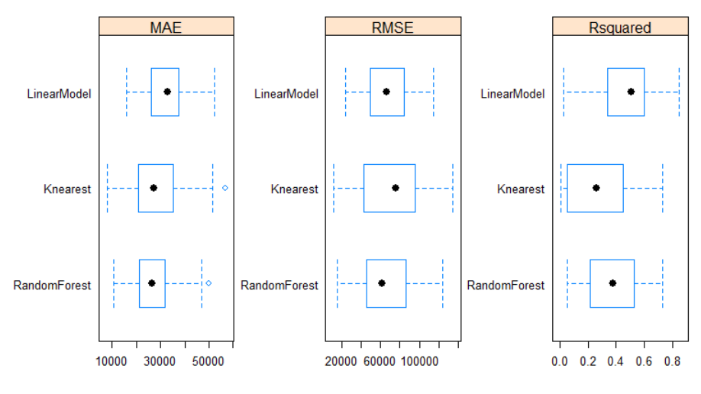
Model accuracy
Graphical representation of Mean Absolute Error, Root Mean Square Error and Rsquared value of all three models

Slide 13
Findings and Conclusion
Random Forest is the best model because of the lowest RMSE
Highest number of likes category – People and Blogs (Category id 22)
Title including : ‘ATTACKED BY A POLICE DOG!!’, ‘IM GONNA BE A FATHER (Things Got Awkward)’, ‘I Bought An Entire Outfit Blindfolded’ etc. received highest number of likes.
Highest number of views category – Sports (Category id 17)
Title including : ‘Chargers vs. Broncos | NFL Week 1 Game Highlights’, ‘Nerf Bow Trick Shots | Dude Perfect’ etc. received highest number of views.

Slide 14
Thank You

